Slide 1
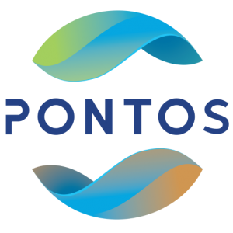
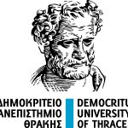
Common borders. Common solutions.
PONTOS HACKATHON
October 2022
[Name of the team]
PONTOS-EU.AUA.AM

Slide 2
Common borders. Common solutions.
Challenge 1: Generate new ideas using PONTOS operational platform and mounted online services/tools

Slide 3
Common borders. Common solutions.
[Add the topic of the Challenge]
[Describe why you selected this particular topic. You can add picturs as needed.]

Slide 4
Common borders. Common solutions.
[Topic of the Challenge]
[Describe the problem you want to address.
Elaborate how your suggested idea will solve the problem? You can add picturs as needed.]

Slide 5
Common borders. Common solutions.
[Topic of the Challenge]
[How will the PONTOS platform help you achieve your goals? You can add picturs as needed.]

Slide 6
Common borders. Common solutions.
[Topic of the Challenge]
[What impact will your solution have? ]

Slide 7
Common borders. Common solutions.
[Topic of the Challenge]
[Describe the steps to reaching your solution.]

Slide 8
Common borders. Common solutions.
[Topic of the Challenge]
[List the expected outcomes/results.]

Slide 9
Common borders. Common solutions.
Challenge 2: Suggestion to create useful application (or stand-alone solution/tool) for the PONTOS Platform using the Copernicus data

Slide 10
Common borders. Common solutions.
[Name of the Tool]
[Describe your suggested application or tool and its aim.]

Slide 11
Common borders. Common solutions.
[Name of the Tool]
[What problem(s) will the tool solve?]

Slide 12
Common borders. Common solutions.
[Name of the Tool]
[Describe the steps to developing your application or tool:
What data will it use?
How the data will be used to solve the problem?
How will it complement the PONTOS platform?
What will be the output?
What will be the output format?
Who will benefit from this tool?
What kind of impact will the tool have?]

Slide 13
Common borders. Common solutions.
Joint Operational Programme Black Sea Basin 2014-2020
Copernicus Assisted Environmental Monitoring across the Black Sea Basin – PONTOS
December 2022
Joint Operational Programme Black Sea Basin 2014-2020 is co-financed by the European Union
through the European Neighbourhood Instrument and by the participating countries: Armenia,
Bulgaria, Georgia, Greece, Republic of Moldova, Romania, Turkey, and Ukraine.
This publication has been produced with the financial assistance of the European Union.
The contents of this publication are the sole responsibility of Copernicus assisted environmental
monitoring across the Black Sea Basin – PONTOS and can in no way be taken to reflect the
views of the European Union.

